Slide 1
Science Communication
Alexander Hartz
Mentors:
Annie Wargetz & Ross DuBois
Arizona Space Grant Symposium
Arizona State University
April 18th

Slide 2
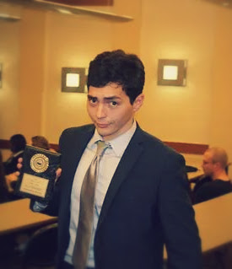
Introduction
Sophomore
Philosophy Major
Creative Writing Minor
Science Communicator

Slide 3
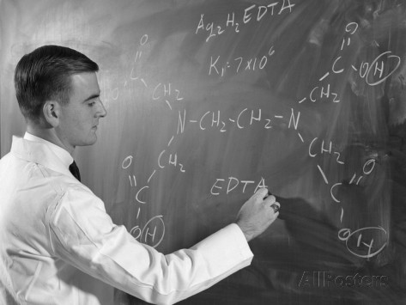
Challenges
Prejudices to Science:
Difficult
Boring
Exclusive
http://www.allposters.com/-sp/1960s-Profile-of-Scientist-Man-in-Lab-Coat-Writing-Out-Chemical-Formula-on-Blackboard-Posters_i10527763_.htm

Slide 4
Objectives
Learn about OSIRIS-REx science and mission
Inform public on OSIRIS-REx
Develop writing skills
“Used with permission from Apple”

Slide 5
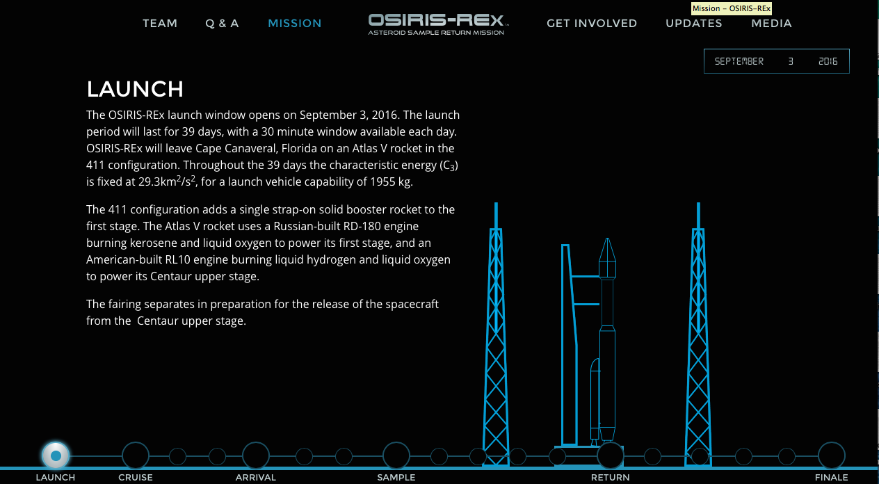
Methods
Scientists
Facebook
Twitter
Social media leads
AsteroidMission.org http://www.asteroidmission.org/
Newsletter

Slide 6
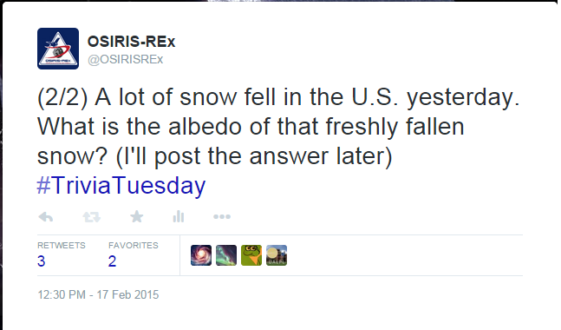
Activities
#triviatuesday
Q&A Responses
Moodle
Asteroids A-Z
Fact Sheet
https://twitter.com/osirisrex

Slide 7
Results
Knowledge of mission science
Communication to public
Development as a writer and communicator

Slide 8
Interpretation
Keep it important
Keep it engaging
Keep it accurate

Slide 9
Acknowledgements
Space Grant
Susan Brew
Dante Lauretta
OSIRIS-REx Team
Mentors: Annie Wargetz & Ross DuBois

